Slide 1



Workshop Technical info
Value Capture Transformation
February, 2019

Slide 2
February 2019 – Technical Discussions
Workshop workstreams overview
Questions for business
Expectations
Technical layers
Technical architecture - DoD

Slide 3
Feb/19 Workshop – Technical Overview
Industry System
Multi Trait & Industry System
Functional changes to enable multi trait and multi trait owner requirements
POD
Multi-
plication
Sales
LSS
...
Technical changes to decouple from Bayer’s infrastructure
Legacy Retirement
Redesign and migrate Legally Saved Seeds, Master Data & Parameters to the cloud
New Features & Enhancements
POD new features like Detailed Model and Adjustments
Sales and Multiplication functional enhancements
Technical enhancements to keep healthy support and compliance levels
3

Slide 4
Industry System Work Stream
Technical Changes (Layers)
Goals
10- Ownership Transition (includes ISO protocols)
Transition AWS and cloud service accounts’ ownership,
and also disable Bayer’s ISO protocols and enable new owner’s security protocols
9- DevOps Tools
Move to independent instances of Jira / Github
Closer to the transition
8- Monitoring & Logging
Move to independent instances of Grafana / Kibana / Slack
7- Access Management
Move from Bayer’s PingId to another solution / independent instance
6- Secrets Management
Move from Bayer’s Vault to independent instance
5- API Management
Move from Bayer’s Akana / Ocelot to independent instances
4- Messaging Platform
Move from Bayer’s Kafka to an independent instance
3- Database Services
Migrate databases to the new AWS account
2- App Container / Serverless + CI/CD
Migrate apps from CloudFoundry (Sales and Multiplication) / AWS Labda (POD)
to independent container / serverless instances with integrated CI/CD framework
+ Fundamental
1- Cloud Service Provider
Create an independent AWS account

Slide 5
Questions for business Industry system design depends on those questions
Devs questions for business – would like to have some time for it
What does the industry system look like?
What does the login flow / user auth process look like? Where does the responsibility lie there?
What is the expectation of the Industry System Roadmap? (Important for knowing if we can put off migrating from a few of our core services, Github, Npm / Maven repositories, etc.)
Roadmap of migrating legacy system before Industry System goes live.
Features to be migrated or enhanced as part of the Industry System.
Priority and roadmap of the migration plan.
During migration, we should be able to support both Bayer and Industry System inter-operability.
What is the scope of each Trait System (Bayer) (like Billing etc..) with Industry System in live.
What does support look like (IE how much can we lean on expensive hosted plans vs. spending that money on support staff Bayer / Industry system)
Customer 360 data integration
Roadmap for Multi-company and Multi-traits features

Slide 6
Industry System - Technical goals
Overall challenges
Main goal, at the end, is to build a “New Company” system, from scratch.
Technical architecture needs strategies:
Environments setup
Dev, It & Prod
New tools setup
AWS account migration
Target features to migrate
Support Model (Support groups and others currently supporting ITS & POD)
Migration strategy (Data and configurations)
Refactoring features
Regulatory stuff
SOX & ISO
Bayer’s ISO protocols and enable new owner’s security protocols

Slide 7
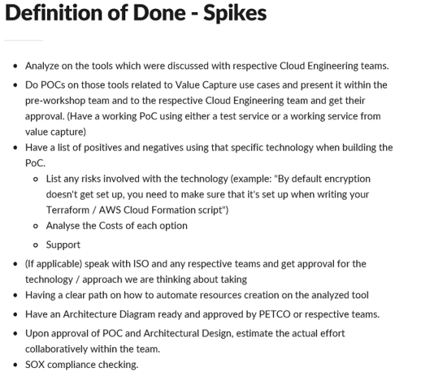
Workshop will have high level estimations and assumptions on those
After goes with POC, team could come back and do a better estimation
Couple of sessions team were more confident than others, but still it is a fact that an estimation review is needed

Slide 8
Industry System Work Stream
Technical Changes (Layers)
Goals
10- Ownership Transition (includes ISO protocols)
Transition AWS and cloud service accounts’ ownership,
and also disable Bayer’s ISO protocols and enable new owner’s security protocols
9- DevOps Tools
Move to independent instances of Jira / Github
Closer to the transition
8- Monitoring & Logging
Move to independent instances of Grafana / Kibana / Slack
7- Access Management
Move from Bayer’s PingId to another solution / independent instance
6- Secrets Management
Move from Bayer’s Vault to independent instance
5- API Management
Move from Bayer’s Akana / Ocelot to independent instances
4- Messaging Platform
Move from Bayer’s Kafka to an independent instance
3- Database Services
Migrate databases to the new AWS account
2- App Container / Serverless + CI/CD
Migrate apps from CloudFoundry (Sales and Multiplication) / AWS Labda (POD)
to independent container / serverless instances with integrated CI/CD framework
+ Fundamental
1- Cloud Service Provider
Create an independent AWS account

Slide 9


Industry System Work Stream
Good to talk about it
DoD WIP
Technical Changes (Layers)
1- Cloud Service Provider
Create an independent AWS account
Why it is needed the POD account and migration?
POD Inc Requirements
Lambda concurrent execution limits
POD Isolation from Monsanto Infrastructure
Account Migration
POD is a module of current Monsanto VCT. It is needed to decouple POD Inc specific features from Monsanto specific requirements.
Lambda concurrent executions has a limit per account. Currently POD module is running in a company wide shared AWS account, so many applications compete for these limited resources. This limit can be increased, but at some point is recommended to isolate our application to a separate AWS account given it’s high load.
The account migration will help on improving maintenance, availability and CloudOps support model separated from Monsanto.
Entities separation will define new POD legal boundaries.

Slide 10
POD account Migration
Proposed solution
Automate as much as possible
Manually migrate resources that are not easy to automate or is not worth to spend the time to automate it
Benefits
Automate as much as possible
Manually migrate resources that are not easy to automate or is not worth to spend the time to automate it

Slide 11
POD Account migration
Plan for major tasks
IAM
Create roles
Assume role from PING
VPC
Creation
Security Groups
Jenkins
Update lambda jobs configuration (92+ repositories * 4 environments)
Lambda deployments
API Gateway
Automation
Migrate API Gateway through swagger export
Add API Gateway role to all paths
S3
Terraform for 328 resources
Lambdas config
Cloudfront
Moving files with AWS cli
CloudWatch
Manually generate (1 resource)
Bastion Servers
VPC Peering
Jenkins deploy config
Uis config
Tags

Slide 12
Industry System Work Stream
Technical Changes (Layers)
Goals
10- Ownership Transition (includes ISO protocols)
Transition AWS and cloud service accounts’ ownership,
and also disable Bayer’s ISO protocols and enable new owner’s security protocols
9- DevOps Tools
Move to independent instances of Jira / Github
Closer to the transition
8- Monitoring & Logging
Move to independent instances of Grafana / Kibana / Slack
7- Access Management
Move from Bayer’s PingId to another solution / independent instance
6- Secrets Management
Move from Bayer’s Vault to independent instance
5- API Management
Move from Bayer’s Akana / Ocelot to independent instances
4- Messaging Platform
Move from Bayer’s Kafka to an independent instance
3- Database Services
Migrate databases to the new AWS account
2- App Container / Serverless + CI/CD
Migrate apps from CloudFoundry (Sales and Multiplication) / AWS Labda (POD)
to independent container / serverless instances with integrated CI/CD framework
+ Fundamental
1- Cloud Service Provider
Create an independent AWS account

Slide 13
Industry System Work Stream
Good to talk about it
DoD WIP
Technical Changes (Layers)
2- App Container / Serverless + CI/CD
Migrate apps from CloudFoundry (Sales and Multiplication) / AWS Labda (POD)
to independent container / serverless instances with integrated CI/CD framework
Open source Cloud Foundry Instance
very expensive
needs a dedicated engineer to setup and support
Host Pivotal Cloud Foundry (PCF) on AWS
is not a hosted service on AWS
we have to take care of setting up the service manually on AWS EC2 instances and manage all the updates
EKS
more expensive than Fargate/ECS
doesn't support all the features as supported by independent Kubernetes system
NOT PREFFERED
NOT PREFFERED
not integrated with Fargate which makes it difficult to manage Container Instances
NOT PREFFERED
ECS with Fargate
AWS takes care of managing Container instances
PREFERRED
Summary:
We decided on the tool we need to use for Container Management Service (ECS with Fargate)
Analysis on the option of CI/CD layer partially depends on the POC of the Container Management Service.

Slide 14
Industry System Work Stream
Technical Changes (Layers)
Goals
10- Ownership Transition (includes ISO protocols)
Transition AWS and cloud service accounts’ ownership,
and also disable Bayer’s ISO protocols and enable new owner’s security protocols
9- DevOps Tools
Move to independent instances of Jira / Github
Closer to the transition
8- Monitoring & Logging
Move to independent instances of Grafana / Kibana / Slack
7- Access Management
Move from Bayer’s PingId to another solution / independent instance
6- Secrets Management
Move from Bayer’s Vault to independent instance
5- API Management
Move from Bayer’s Akana / Ocelot to independent instances
4- Messaging Platform
Move from Bayer’s Kafka to an independent instance
3- Database Services
Migrate databases to the new AWS account
2- App Container / Serverless + CI/CD
Migrate apps from CloudFoundry (Sales and Multiplication) / AWS Labda (POD)
to independent container / serverless instances with integrated CI/CD framework
+ Fundamental
1- Cloud Service Provider
Create an independent AWS account

Slide 15
Industry System Work Stream
Good to talk about it
DoD WIP
Technical Changes (Layers)
3- Database Services
Migrate databases to the new AWS account
Both VCT and POD use AWS Aurora PostgreSQL instances. POD also use AWS ElastiCache Redis. We will have the same scheme in the new accounts, but some effort and care is needed to assure being SOX and to warranty data consistency.
Alternatives:
Use AWS Database Migration Service
Snapshots
Pgdump / Pgrestore
Improvement opportunity:
Event Store
PostgreSQL Timescale plugin
Apache Cassandra NoSQL DB
Risk / Assumptions
We will need given special permissions if we go with alt 1
If don’t go with alt1, we should consider a higher maintenance window while migration process runs
Event Store improvements need independently host and maintenance
Pos:
Migration doesn’t implies researching new DB technologies, we will use the same we have
SaaS solutions
Alt 2: VCP Peering would let us to share the snapshots, avoiding to move all data through network
Cons:
Refactor code: we need to adapt our code to the new databases hosts

Slide 16
Industry System Work Stream
Technical Changes (Layers)
Goals
10- Ownership Transition (includes ISO protocols)
Transition AWS and cloud service accounts’ ownership,
and also disable Bayer’s ISO protocols and enable new owner’s security protocols
9- DevOps Tools
Move to independent instances of Jira / Github
Closer to the transition
8- Monitoring & Logging
Move to independent instances of Grafana / Kibana / Slack
7- Access Management
Move from Bayer’s PingId to another solution / independent instance
6- Secrets Management
Move from Bayer’s Vault to independent instance
5- API Management
Move from Bayer’s Akana / Ocelot to independent instances
4- Messaging Platform
Move from Bayer’s Kafka to an independent instance
3- Database Services
Migrate databases to the new AWS account
2- App Container / Serverless + CI/CD
Migrate apps from CloudFoundry (Sales and Multiplication) / AWS Labda (POD)
to independent container / serverless instances with integrated CI/CD framework
+ Fundamental
1- Cloud Service Provider
Create an independent AWS account

Slide 17
Industry System Work Stream
Good to talk about it
DoD WIP
Technical Changes (Layers)
4- Messaging Platform
Move from Bayer’s Kafka to an independent instance
AWS MKS Service
Managed directly by AWS
Pay as you use. No additional license fee
Confluent Kafka as a Service
Hosted as a service with Confluent UI and other components.
Liable SLA and good response time - Package as a service make it more usable and
AWS Kineses
Check if can be an alternative solution to migrate our applications to Kineses
Check AWS Kinesis throughput.
Easy maintainability
CONS: It is in Public Preview phase. Not matured yet.
Pay is more
CONS: Subscription required. Charge is per topic basis. Cost would be more.
CONS: Need to check with Confluent team
Host Independent Kafka Instance
Datahub team has Terraform scripts to setup a new Kafka cluster integrating with other components like Elastic search, Grafana, Kibana.
Monitoring, Logging -> Those can be leverage directly,
CONS: Kafka Portal is written by Datahub team and completely coupled with Bayer infrastructure like Velocity/PAPI and other Bayer accounts
Needs dedicated resource: One Kafka Engineer, One DevOps eng, One AWS developer required.

Slide 18
Industry System Work Stream
Technical Changes (Layers)
Goals
10- Ownership Transition (includes ISO protocols)
Transition AWS and cloud service accounts’ ownership,
and also disable Bayer’s ISO protocols and enable new owner’s security protocols
9- DevOps Tools
Move to independent instances of Jira / Github
Closer to the transition
8- Monitoring & Logging
Move to independent instances of Grafana / Kibana / Slack
7- Access Management
Move from Bayer’s PingId to another solution / independent instance
6- Secrets Management
Move from Bayer’s Vault to independent instance
5- API Management
Move from Bayer’s Akana / Ocelot to independent instances
4- Messaging Platform
Move from Bayer’s Kafka to an independent instance
3- Database Services
Migrate databases to the new AWS account
2- App Container / Serverless + CI/CD
Migrate apps from CloudFoundry (Sales and Multiplication) / AWS Labda (POD)
to independent container / serverless instances with integrated CI/CD framework
+ Fundamental
1- Cloud Service Provider
Create an independent AWS account

Slide 19
Industry System Work Stream
Good to talk about it
DoD WIP
Technical Changes (Layers)
6- Secrets Management
Move from Bayer’s Vault to independent instance
Conclusions
We are using Akana & Api Gateway in order to expose our microservices.
Both tools have different timeouts. Actually are some microservices are taken more than 30 sec. For this reason, we had meetings with people from Integration Architect.
NGNIX & AWS in order to avoid the timeout and find the best alternative for us.
POS
Knowledge about Api Gateway & Akana
Cons
Refactor code: we need to adapt our code to the final solution
Alternatives:
Fargate
Use api gateway as web socket.
Use the callback pattern
Use step functions
Use Apigee, Akana as Saas or nginx.
Risks/Assumptions
Nginx is not a SaaS solution.
Need independently host and maintaiance. Apigee, Akana & Axway support
The AWS Api gateway timeout is not configurable and there aren't any plan in order to change this

Slide 20
Industry System Work Stream
Good to talk about it
DoD WIP
Technical Changes (Layers)
5- API Management
Move from Bayer’s Akana / Ocelot to independent instances
NGINX+ (Needs deep research) – Demo from vendor on Friday 8th
Handles health checks, api management, monitoring, networking. Nginx uses OpenID Connect which can interact with API Gateway (there is also a module specifically for Ping).
There are a number of modules that can dynamically be added to Nginx. They have for openID connect (relies for JWT), they have some for other widely used OAuth2 integrations.
Support for writing your own modules
Integrations with AWS, GCP, etc. Example: AWS load balancer.
Their controller product is a centralized management / configuration / api gateway management platform. Inside there is the ability to define secure API keys, and interact with the metrics that are being captured inside of nginx.

Slide 21
Industry System Work Stream
Technical Changes (Layers)
Goals
10- Ownership Transition (includes ISO protocols)
Transition AWS and cloud service accounts’ ownership,
and also disable Bayer’s ISO protocols and enable new owner’s security protocols
9- DevOps Tools
Move to independent instances of Jira / Github
Closer to the transition
8- Monitoring & Logging
Move to independent instances of Grafana / Kibana / Slack
7- Access Management
Move from Bayer’s PingId to another solution / independent instance
6- Secrets Management
Move from Bayer’s Vault to independent instance
5- API Management
Move from Bayer’s Akana / Ocelot to independent instances
4- Messaging Platform
Move from Bayer’s Kafka to an independent instance
3- Database Services
Migrate databases to the new AWS account
2- App Container / Serverless + CI/CD
Migrate apps from CloudFoundry (Sales and Multiplication) / AWS Labda (POD)
to independent container / serverless instances with integrated CI/CD framework
+ Fundamental
1- Cloud Service Provider
Create an independent AWS account

Slide 22
Industry System Work Stream
Good to talk about it
DoD WIP
Technical Changes (Layers)
6- Secrets Management
Move from Bayer’s Vault to independent instance
Conclusions
We are currently using different approaches to manage secrets between VCT and POD:
For VCT we are currently using Vault in order to secure our secrets
Rotation for (non-DB passwords) secrets is supported natively by Vault.
Rotation for DB passwords has required extra effort from our side since we have to integrate
with RDS (we have already worked to have an automatic rotation flow - still not productive)
For POD we are currently encrypting our secrets. The keys to encrypt/decrypt are stored in AWS KMS.
Rotation for DB passwords is still not supported (any password rotation will need re-deployment
of the lambda/micro service since we are storing encrypted credentials inside parameters)
As team we agreed that no matter the vendor/solution we need a SaaS alternative to replace our
Vault instance/cluster.
After some research we believe that AWS Secret Management could fit our needs.
We have talked and shared ideas both with Bayer's CouldOps team and with our dedicated AWS support team and they have agreed that the best move is to move from Vault to AWS Secret Management.
Alternatives:
Unify Secrets management with just one SaaS alternative: AWS Secret Management
VCT: Replace Vault with AWS Secret Management
POD: Start using AWS Secret Management instead of storing encrypted secrets on lambda configs
POS
Only one way to manage secrets within all the platform.
Since AWS Secret Management is part of AWS ecosystem, integration should be
straight forward.
AWS Secret management could natively manage RDS DB password rotation
no custom process should be needed. - SaaS solution
Cons
Refactor code: we need adapt our code to the final solution.
Risks/Assumptions
Assumption: All the secrets stored in AWS Secret Manager are encrypted using AWS KMS. Cost will differ depending on the config: using the default KMS data encryption key is free, using a custom one will cost. We will assume that is ok to use default one.
Risk: We need to find an alternative to do jump box from our local envs to AWS since we are removing Vault. How we could federate our dev users?

Slide 23
Industry System Work Stream
Technical Changes (Layers)
Goals
10- Ownership Transition (includes ISO protocols)
Transition AWS and cloud service accounts’ ownership,
and also disable Bayer’s ISO protocols and enable new owner’s security protocols
9- DevOps Tools
Move to independent instances of Jira / Github
Closer to the transition
8- Monitoring & Logging
Move to independent instances of Grafana / Kibana / Slack
7- Access Management
Move from Bayer’s PingId to another solution / independent instance
6- Secrets Management
Move from Bayer’s Vault to independent instance
5- API Management
Move from Bayer’s Akana / Ocelot to independent instances
4- Messaging Platform
Move from Bayer’s Kafka to an independent instance
3- Database Services
Migrate databases to the new AWS account
2- App Container / Serverless + CI/CD
Migrate apps from CloudFoundry (Sales and Multiplication) / AWS Labda (POD)
to independent container / serverless instances with integrated CI/CD framework
+ Fundamental
1- Cloud Service Provider
Create an independent AWS account

Slide 24

Industry System Work Stream
Good to talk about it
DoD WIP
Technical Changes (Layers)
7- Access Management
Move from Bayer’s PingId to another solution / independent instance
Conclusions
We are using Ping that it is maintained nowadays by Bayer CloudOps Team. So, the idea is to look into a tool that could be auto maintained by an external team paying a fee per usage.
The tool that we decide, needs to follow the protocol OAuth2 that we already have now with ping and also it is needed SAML standard for SSO and federation login.
Besides of authentication tool, we need to think in authorize the request incoming related to the user authenticated. So, It will be nice to have everything in the same Tool.
Also we need to cover our Bayer Security Compliance.
This research and conclusion is for Amazon Cognito.
PROS
It works with OAuth2 and SAML standards.
It provides APIs where we could develop.
It is possible to create creation user workflows.
We can create different levels and hierarchies of users with Create Users Pool, Users Groups and Roles, IAM Policies.
We can use IAM polices to authorize access to endpoints that we have in API Gateway.
It has Migration Users tools. Also we could keep the current passwords but we need to revalidate if it will be Compliance.
Probably we could use Cognito for Development tools also using federate login.
It is cheap: first 50,000 free, until 900,000 it cost $0.00550 for MAUs (Monthly active users) to sign in using the pool. And for users that use SAML, first 50,000 free and then $0.015 for MAUs
Risks/Assumptions
We probably will need to develop some middleware to be compliance.
We will need to develop some tools to automate users, profile, entitlements migrations.
Is needed to research more about Backups.
CONS
We need to develop layers to guarantee some SOX compliance polices or ask to Amazon team to include it.
We need to create new polices and relations for all the APIs that we have now.
We need to create new groups that will match with our currents profiles.
We need to makes the new relations between users and groups

Slide 25
Industry System Work Stream
Technical Changes (Layers)
Goals
10- Ownership Transition (includes ISO protocols)
Transition AWS and cloud service accounts’ ownership,
and also disable Bayer’s ISO protocols and enable new owner’s security protocols
9- DevOps Tools
Move to independent instances of Jira / Github
Closer to the transition
8- Monitoring & Logging
Move to independent instances of Grafana / Kibana / Slack
7- Access Management
Move from Bayer’s PingId to another solution / independent instance
6- Secrets Management
Move from Bayer’s Vault to independent instance
5- API Management
Move from Bayer’s Akana / Ocelot to independent instances
4- Messaging Platform
Move from Bayer’s Kafka to an independent instance
3- Database Services
Migrate databases to the new AWS account
2- App Container / Serverless + CI/CD
Migrate apps from CloudFoundry (Sales and Multiplication) / AWS Labda (POD)
to independent container / serverless instances with integrated CI/CD framework
+ Fundamental
1- Cloud Service Provider
Create an independent AWS account

Slide 26
Industry System Work Stream
Good to talk about it
DoD Done
Technical Changes (Layers)
8- Monitoring & Logging
Move to independent instances of Grafana / Kibana / Slack
"Distributed monitoring is probably the area in need of the most significant improvement" - 2018
(Mike Roberts – Serverless Architectures).

Slide 27
Monitoring & Logging
Considered solutions: ELK Stack and/or CloudWatch with X-Ray from AWS;
CloudWatch
Monitor applications to answer 3 basic questions:
How is my application doing?
Why is my application performing this way?
Who is impacted by the issues?
Centralize logs and create custom alerts
ELK Stack
Elasticsearch API to centralize logs based on rules;
Logstash to read existing log files from existing applications (e.g.: Cloud Foundry)
Kibana to visualize logs and create custom dashboards;
APM Elastic Server to listen to application events and errors;
X-PACK using the Alert and Machine Learning tools to identify patterns on logs and react to them;
Our Proxy Monitoring API to create custom rules for each project (e.g.: Notify Business if ROL Calculation is wrong / Open Jira issue and send link throughout channels (slack, SMS, etc.) for business tracking);

Slide 28
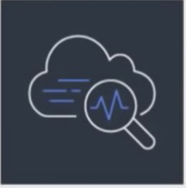
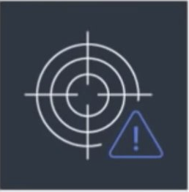
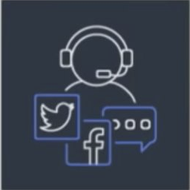


Monitoring & Logging
Monitoring matters because...
Real-time troubleshooting
Customer
experience
Visibility
Applications = $$
Operational
Business

Slide 29
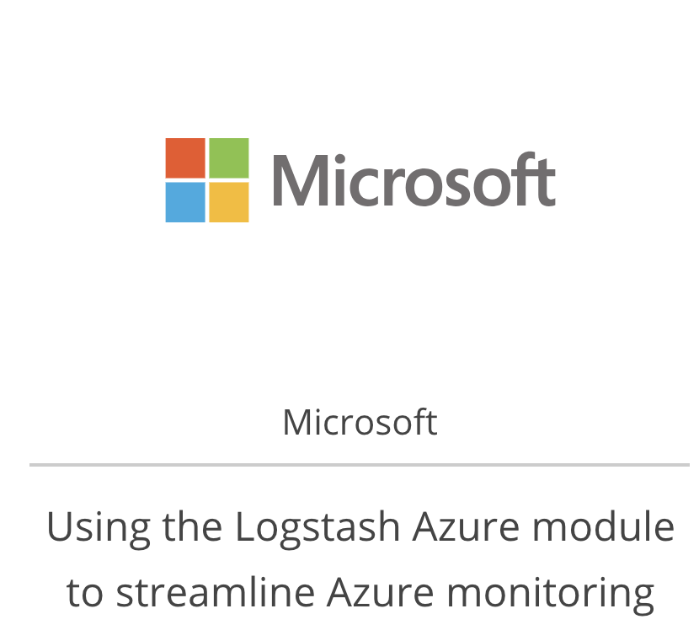
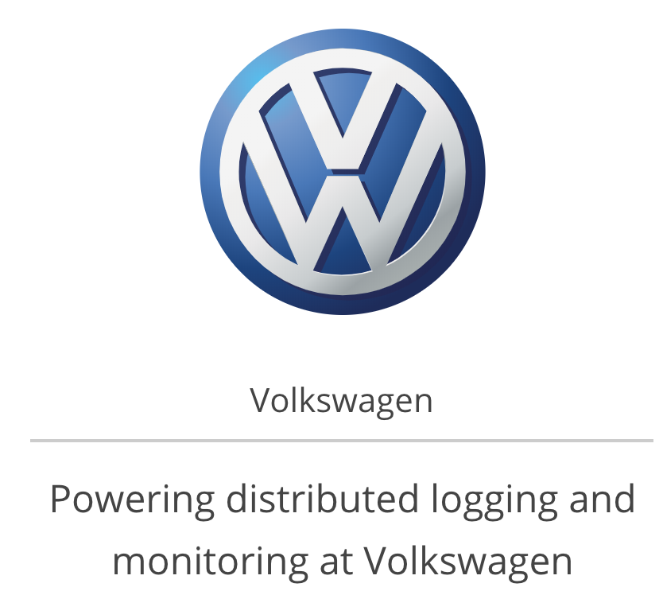
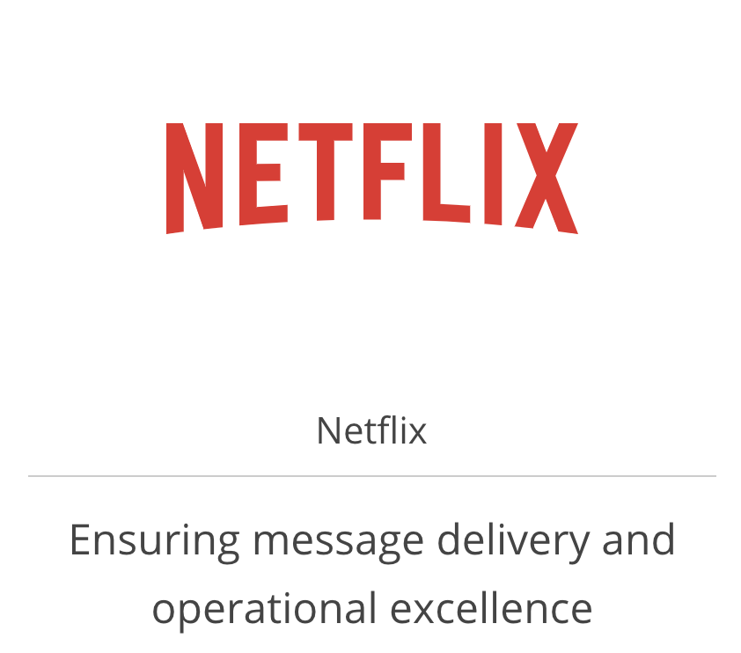
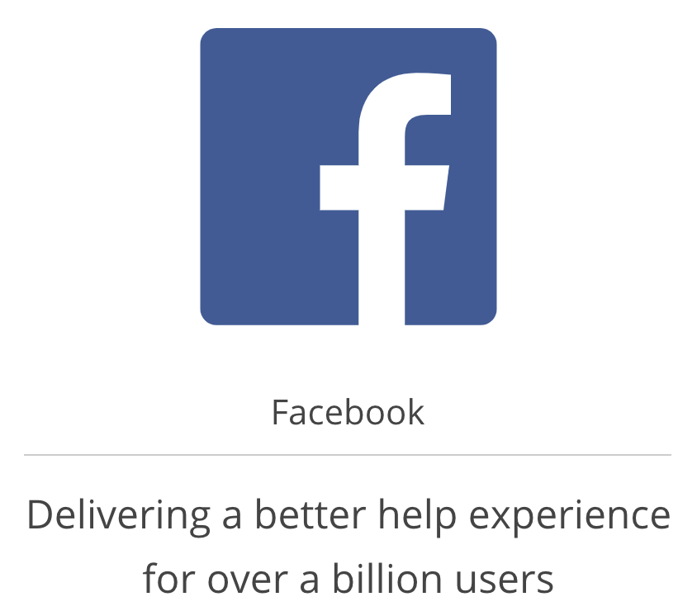
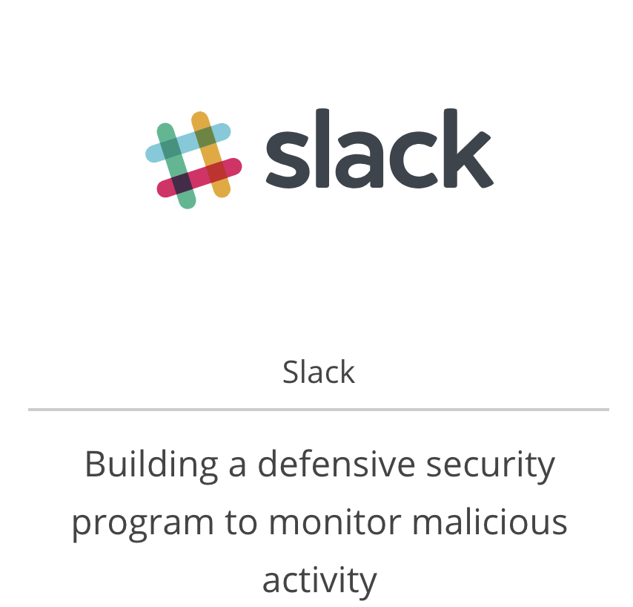
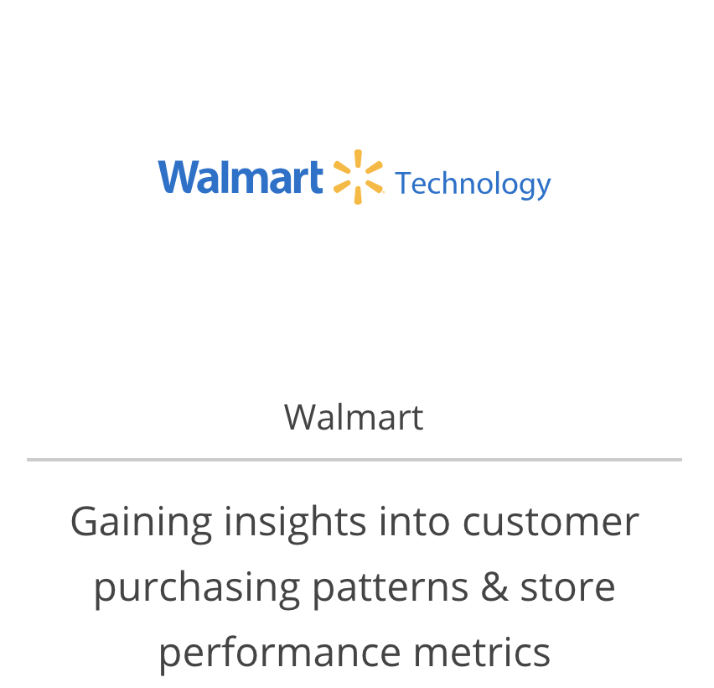
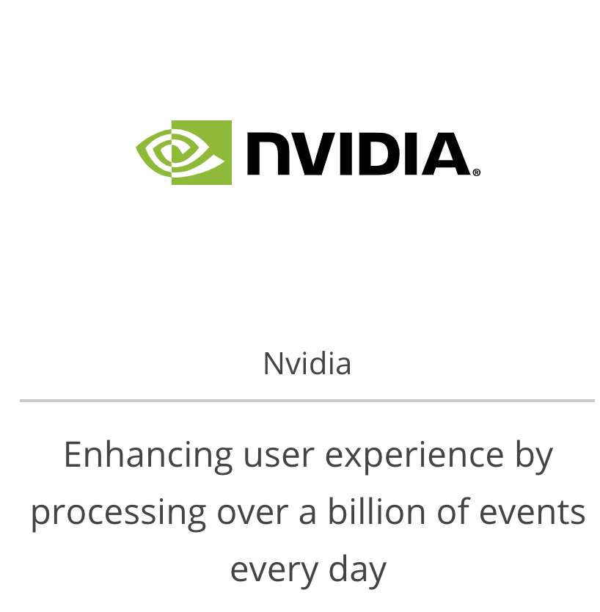
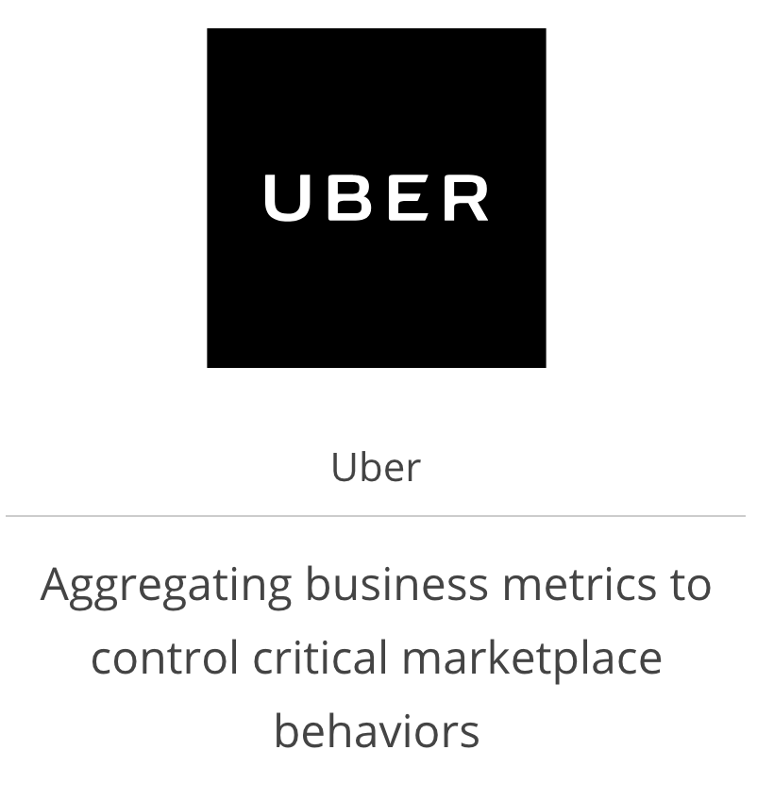

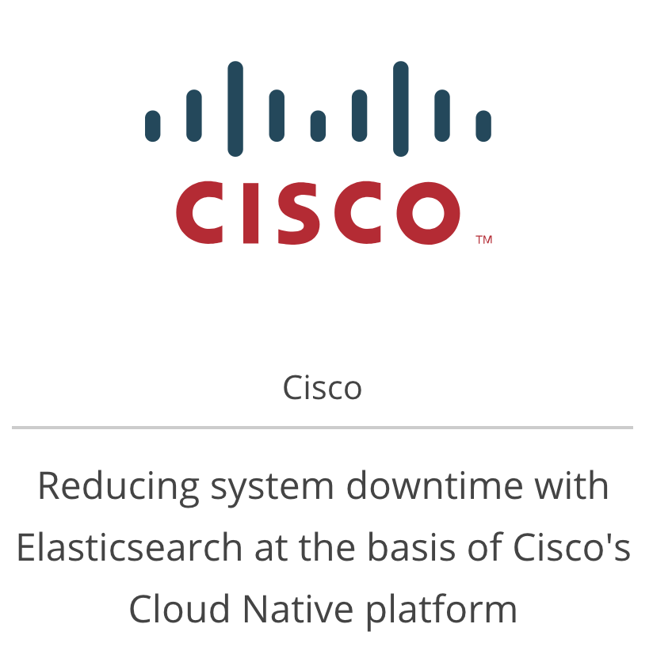



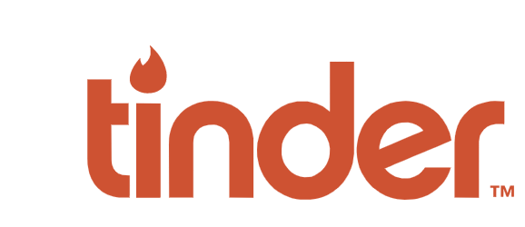

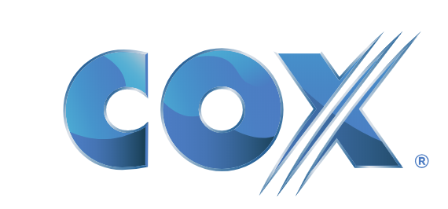

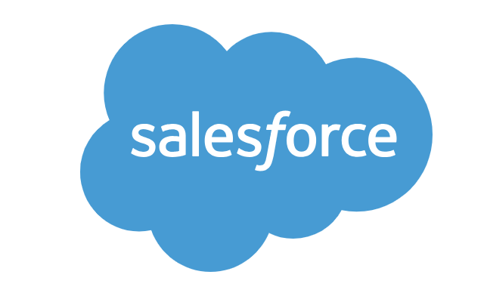


Monitoring & Logging
ELK uses cases
And some more...

Slide 30
Pros & Cons
Pros
Reveal and manage data anomalies in a proactive manner;
Improve data integrity and in turn business integrity;
Reduce IT and organizational costs;
Increase confidence using and relying on organization systems;
Optimize and improve business procedures;
Focus on SLA compliance;
Centralized data allowing for exploration of relationships between data.
Help IT to assist proactively in front of system anomalies, providing better customer experience
Cons
Manage additional business software;
Monitoring tool learning curve;

Slide 31
Doubts / Concerns to define with Business and PM
Can we consider using Elastic Cloud for Elasticsearch and Kibana hosting?
How much effort (%) from the sprint the team can focus to align our existing projects with a Monitoring Tool?
If one of the monitoring tool fails on production, how will this ticket be addressed? By whom?
Sync up with business which functionalities have high critical transactions and determine which ones we will start to implement.

Slide 32
Industry System Work Stream
Technical Changes (Layers)
Goals
10- Ownership Transition (includes ISO protocols)
Transition AWS and cloud service accounts’ ownership,
and also disable Bayer’s ISO protocols and enable new owner’s security protocols
9- DevOps Tools
Move to independent instances of Jira / Github
Closer to the transition
8- Monitoring & Logging
Move to independent instances of Grafana / Kibana / Slack
7- Access Management
Move from Bayer’s PingId to another solution / independent instance
6- Secrets Management
Move from Bayer’s Vault to independent instance
5- API Management
Move from Bayer’s Akana / Ocelot to independent instances
4- Messaging Platform
Move from Bayer’s Kafka to an independent instance
3- Database Services
Migrate databases to the new AWS account
2- App Container / Serverless + CI/CD
Migrate apps from CloudFoundry (Sales and Multiplication) / AWS Labda (POD)
to independent container / serverless instances with integrated CI/CD framework
+ Fundamental
1- Cloud Service Provider
Create an independent AWS account

Slide 33
Industry System Work Stream
Good to talk about it
DoD WIP
Technical Changes (Layers)
9- DevOps Tools
Move to independent instances of Jira / Github
Conclusions
POS
Risks/Assumptions
Cons

Slide 34
Industry System Work Stream
Technical Changes (Layers)
Goals
10- Ownership Transition (includes ISO protocols)
Transition AWS and cloud service accounts’ ownership,
and also disable Bayer’s ISO protocols and enable new owner’s security protocols
9- DevOps Tools
Move to independent instances of Jira / Github
Closer to the transition
8- Monitoring & Logging
Move to independent instances of Grafana / Kibana / Slack
7- Access Management
Move from Bayer’s PingId to another solution / independent instance
6- Secrets Management
Move from Bayer’s Vault to independent instance
5- API Management
Move from Bayer’s Akana / Ocelot to independent instances
4- Messaging Platform
Move from Bayer’s Kafka to an independent instance
3- Database Services
Migrate databases to the new AWS account
2- App Container / Serverless + CI/CD
Migrate apps from CloudFoundry (Sales and Multiplication) / AWS Labda (POD)
to independent container / serverless instances with integrated CI/CD framework
+ Fundamental
1- Cloud Service Provider
Create an independent AWS account

Slide 35
Industry System Work Stream
Good to talk about it
DoD WIP
Technical Changes (Layers)
10- Ownership Transition (includes ISO protocols)
Transition AWS and cloud service accounts’ ownership,
and also disable Bayer’s ISO protocols and enable new owner’s security protocols
Conclusions
POS
Risks/Assumptions
Cons

Slide 36
Meeting notes
Meeting notes from meetings between devs and technical team
AWS
Datahub Team
API Gateway
Cloud engineering Team
Cloud Formation vs Terraform

Slide 37
DoD for Industry System
Same level of understanding and expectations
During workshop
Workshop will have high level estimations and assumptions on Industry System Technical layers
After
After goes with POC, team could come back and do a better estimation
First sprints
Couple of sessions team were more confidence than others, but still it is a fact that an estimation review is needed
Receive the inputs to drive us on achievements
Provide lessons learnt to keep ITS process improvements,

Slide 38
Q&A

